Slide 1



2024-06-14
OSS Strategy
Japan Local Meetup

Slide 2
Today's Agenda
Discuss the Case of Online Services

Slide 3
June
Discuss the case of online services to be held.

Slide 4
current discussion topic

Slide 5
OSPO Adoption Strategy and OSS Strategy
We will discuss this
Recognize the OSS that matters to your business
How to get involved
Contribution
Foundation Sponsor
Maintainer ・・・
What to do in the company to get involved
Rules and processes
KPI
Organization, internal structure and internal cooperation
Compliance
What do we need OSPO to do?
Should we discuss OSS strategy with products and services?
How should we summarize OSS strategy next time?
OSPO Strategy will be recommended by QA.
We will discuss the issues of OSS Strategy The issues of OSPO organization establishment and activities We will not discuss (right now)

Slide 6
How to summarize results
Business
Tertiary
Business
Secondary
Create slides from Spreadsheet
I made it easy
I want to brush up
Business
Tertiary
Business
Secondary
Business Primary
OSS

Slide 7
Sales of services related to OSS (Primary) 2024-03-15 Display

Slide 8
Primary: Companies serving as OSS
The main place of value for the business
Providing value primarily by providing OSS
Linux as an example, like a distro vendor?
Redhat Linux
Cannonical
Windriver
MIRACLE LINUX
Relationship to the OSS community
Maintainer, operator or core member of the Linux community

Slide 9
Primary: Companies serving as OSS
Business challenges
Hardware vendor certification (new hardware support)
Compatibility maintenance (backport)
Security measures (version upgrade and distribution)
Technical support
Business value
OSS itself cannot be sold (It is not prohibited to buy and sell, but as a value, it cannot be sold by itself.)
Offer in combination with OSS (I can verify it myself, but there are many combinations.)
Maintenance alternatives (I can maintain it myself, but it is better and more effective to outsource it.)
Technical inquiries (I can look it up myself, but it's faster to ask.)
Authentication is a business requirement

Slide 10
Primary: Companies serving as OSS
OSS Strategy and Action
Distros can be formed by continuing OSS
Patch posting
Document maintenance (Expansion of developers and users)
Community dissemination, operation support, and operation promotion (maintenance of distro foundation)
Development of OSS leads to expansion of potential customers
Meetup events, seminar events (expansion of users)
Improvement of business value (Brand?)
Continuous patch posting
Forming the de facto
Can be requested by developers
(It may not be a strategy, but patch submission also leads to technical training.)
Patch posting
Community support
Meetup

Slide 11
OSS as a platform If you're on it, and you're using certain features of OSS to provide a service, is it?
Why not put it in a table?
 | Patch posting
Community survival | ◯ ◎
OSS evolution, growing potential customers

Slide 12
2024-03-15
Listed separately by telecommunication business (business entity)
Slide and Spreadsheet URL (also homework)
4/12 from 15:00.

Slide 13
2024-04-12
In the Automotive and Telecommunications Industries

Slide 14
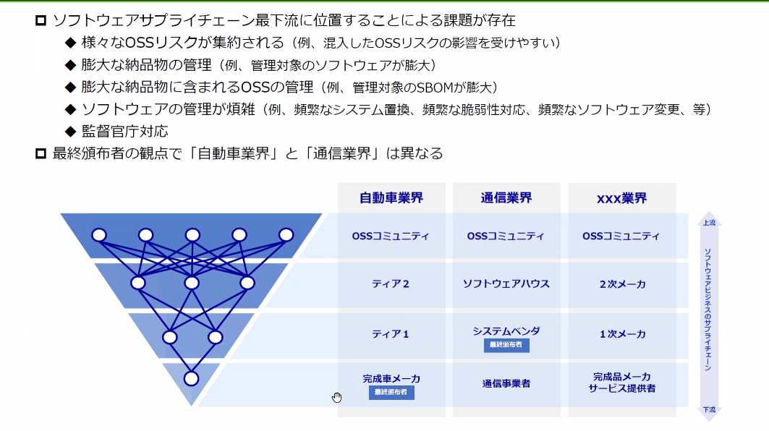
2024-04-12
The OSS community is important in both the telecommunication and automotive industries
It is being explored as an OSS strategy
Recognition that activities for the community to remain are necessary because the elimination of OSS is a problem
Discussing that the finished car manufacturers receive the finished products from Tier 1
Industry standards are made by the community
Looking at the big flow of 5 or 10 years, the impression is that the finished product manufacturers/telecommunication carriers present the flow
In the case of telecommunication carriers, 3GPP is such a flow
Including interoperability, it is sound if it is made by the OSS community

Slide 15
2024-04-12
Project to develop and standardize a Teleco API
https://camaraproject.org/
These projects are needed to be interconnected, and leading them is a good OSS strategy.
How do these cross-industry projects get started?
Sometimes brought to The Linux Foundation for discussion.
Who gets the code base at Open Daylight or something?

Slide 16
2024-04-12
Does SBOM ever return claims?
What if SBOM does not accept software? (Apple and others have certification.)
We are not satisfied with the lack of engineers ・・・
We are aware that there are times when people ask us not to include this license.
Are carriers concerned about AGPL?
Reaching out to the OSS community to review the license?
As the scope of usage expands, it may be important to change the license to suit the usage.
As SBOM evolves, it will become clear which OSS is being used.
Ranking the most important OSS for your business

Slide 17
2024-04-12
I want SBOM generation at build time. I make a request to the OSS community.
It is considered important in the cross-business OSS community.
Imitation of the first mover
👉𢐠Since it is important that the OSS community that we consider important is widely used in business, I think it is also an OSS strategy to give opinions to such business-related OSS.
Do you ever commission OSS activities to client companies?
Not at the moment. The current situation is that we do not commission work to companies with whom we have a contract relationship, but we contribute according to the license.
How about commissioning in the form of giving back (making efforts) to the community?
By contract ・・・ (I want to create an industry-wide culture of contribution)
👉𢐠When we delivered OSS with special features, we were given a choice between adding the maintenance cost of the patch each time we upgraded or allowing us to reduce the cost by returning the developed patch to the community. We were mostly allowed to return the patch to the community.

Slide 18
2024-05-10
For semiconductor vendors

Slide 19
2024-05-10
Business: Suppliers for box manufacturing
Profit and software are separate and not directly linked
Midstream as a supply chain. Upstream IP vendors and wholesale to downstream manufacturers.
Moving from standards first to OSS first
What do you do for the OSS community?
Fostering, sponsorship (to a widely needed community)
Build a community. Hosting.
Intel, NVidia, and others have participated in projects under LF.
Fostering: keeping our semiconductors usable
As for maintenance, I want them to be taken in by the larger community.

Slide 20
2024-05-10
ARM is launching a Linaro-centric nonprofit
that hires software engineers from nonprofits
that are not directly tied to their business.

Slide 21
2024-05-10
For online sales services

Slide 22
2024-06-14
OSS is used for product production (as expected)
OSS is also used as an internal tool
OSS is used for URL shortening, part of a question-answering bot for internal communication tools, etc.
Basic OSS(Python, PHP, etc.) is judged as a sponsor based on the number of uses and importance
Exhibited a booth at OSS-related events. There was a proposal from an engineer, and the company judged and implemented it.
Aimed at networking and motivating engineers
We try to keep the fact that the company is sponsoring the event from the front.

Slide 23
2024-06-14
There is a clear policy for OSS activities
Contributions are possible. We do not collect statistics such as the number of cases.
We use blogs and videos to show that we are actively using OSS and can contribute.
There are no restrictions on activities (to keep engineers motivated).
OSS publishing
We have a Github company account so that we can decide to publish.
There is a publishing flow. It is automated so that we can go through minimal tool checks such as license violations and get checked by each department.
By github repository
After publishing, promote on social media and blogs

Slide 24
2024-06-14
The predecessor of OSPO was when engineers raised the issue of OSS licenses.
Software moving from OSS licenses to Business licenses is a challenge.
Engineers have their antennas up and OSPO is contacted.
Policy violations in scanning tools result in alerts.

Slide 25
July
Looking back and chatting

